Slide 1

Defensive publications
MGT-404
Principles of IP Management
EPFL
25.04.2017
Maria MAINA

Slide 2


Summary
Defensive publications
Dating of documents
Brief overview of no-patent strategies

Slide 3
Summary
Defensive publications
Dating of documents
Brief overview of no-patent strategies

Slide 4
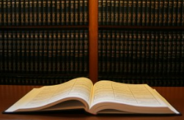
Before starting….
Some vocabulary….

Slide 5
Patent
Type of IP right
Object
How?
Duration
Patents
Inventions
Filing
20 years from filing date

Slide 6
Patent vocabulary
Prior art
Novelty
Inventive step
Notes:
Exclusions / Industrial applicability - New means not part of the prior art
- One most show that for a skilled person, it was not obvious to come to the solution

Slide 7
Prior art
Any information which has been made accessible to the public in any form and anywhere before the date of the patent/design filing, as:
written description, including emails or web pages
oral disclosure, such as public lecture, meeting, ..
sales, offering for sales
radio or television program
etc…

Slide 8

Let us start !

Slide 9
Defensive publications
IP no-patent strategy.
Disclosing an enabling description and/or drawing of a product, apparatus or method.
The disclosure enters in the public domain and becomes prior art.

Slide 10
Defensive publications
Goal: create prior art describing an invention/design in order to prevent others from later obtaining a patent on the same or a closely-related invention.

Slide 11
Defensive publications
State of the art
04.09.2016
24.04.2017
25.04.2017
Publication of A
Filing of a patent application on A

Slide 12
Defensive publications
State of the art
24.04.2017
25.04.2017
Filing of a patent application on A+B
06.03.2017
Publication of B
04.09.2016
Publication of A

Slide 13
Where I can publish?
Where you want, as long as the publication is / could be accessible.
Until recently, there was no really suitable channel for publishing inventions rapidly, cost-effectively and with limited administrative constraints.

Slide 14
Where I can publish?
Traditional technical papers published in a journal.
Internet publications.
Specialized websites.

Slide 15

Papers
Traditional technical papers published in a journal usually imply long delays and the risk to have the text rejected or amended by the reviewers.

Slide 16
Internet discolsures
Internet publications are easier to achieve, but it may be difficult or even impossible to prove later on which information was published and on what date exactly.
Not all web pages mention when they were published. Also, websites are easily updated, yet most do not provide any archive of previously displayed material (…but internet archiving service as the so-called "Wayback Machine" www.archive.org).

Slide 17
Internet discolsures
Neither restricting access to a limited circle of people (e.g. by password protection) nor requiring payment for access (analogous to purchasing a book or subscribing to a journal) prevent a web page from forming part of the state of the art.
It is sufficient if the web page is in principle available without any bar of confidentiality.

Slide 18
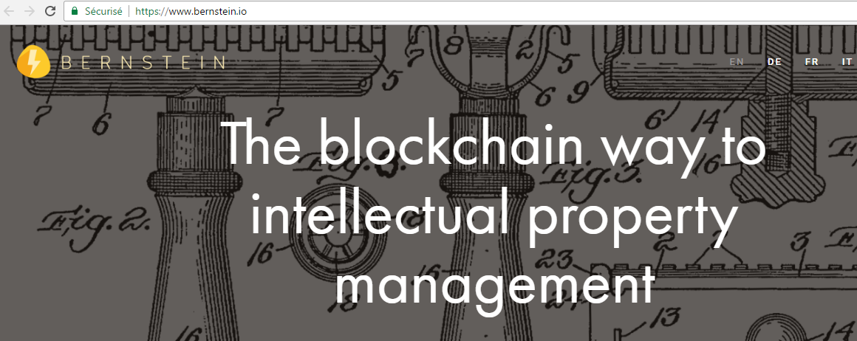
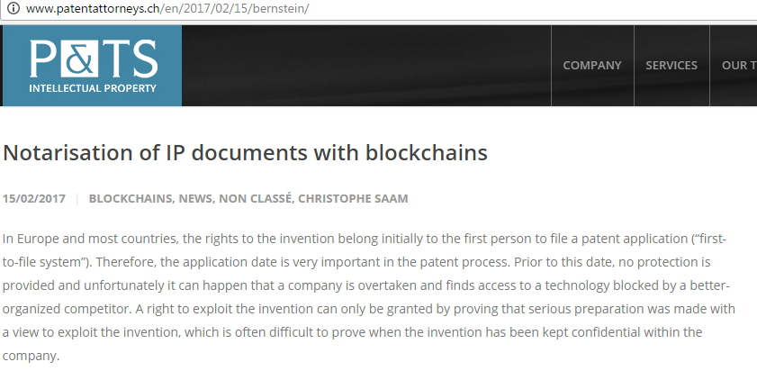
Specialized websites
Suggested to use specialized websites.

Slide 19
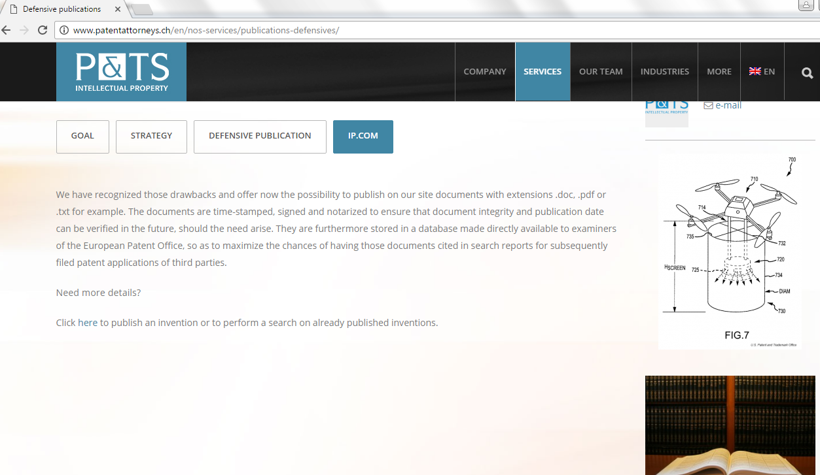
Specialized websites

Slide 20
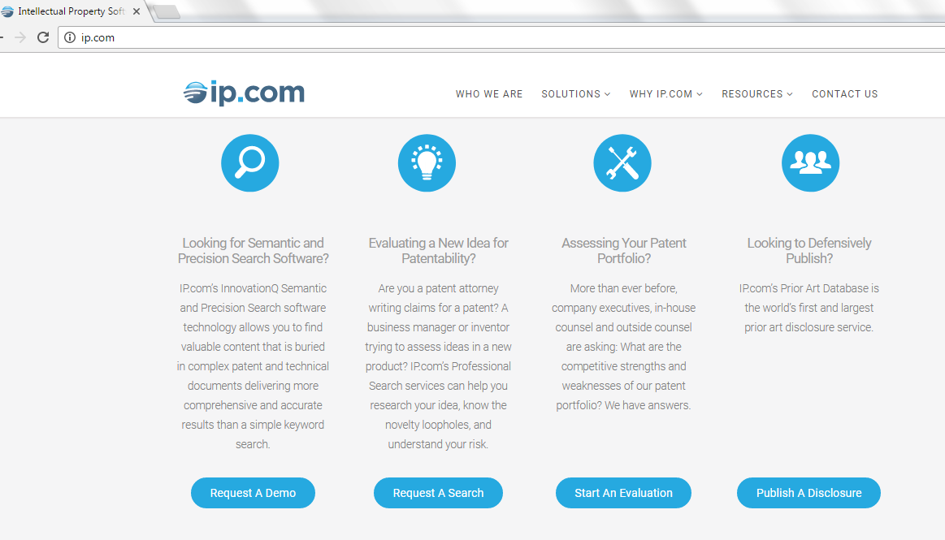
Specialized websites

Slide 21
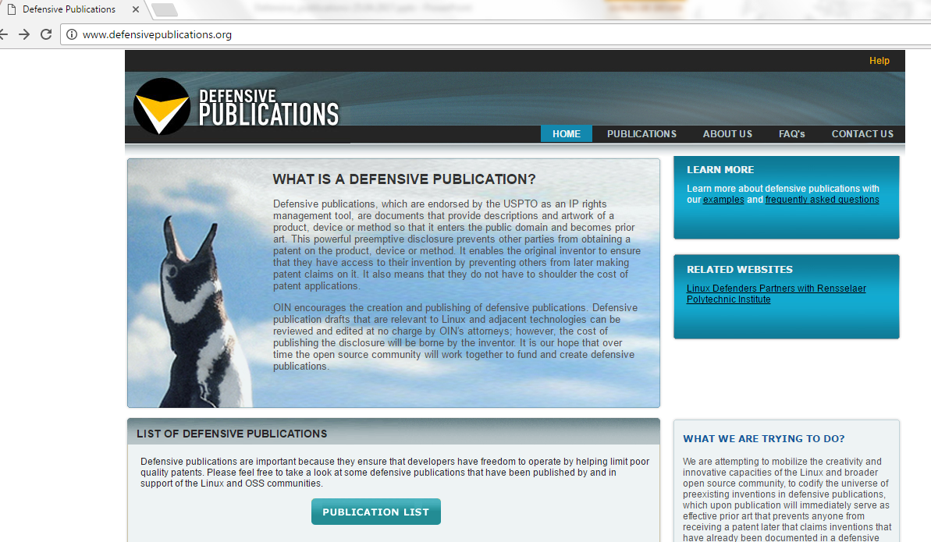
Specialized websites

Slide 22
Defensive publications
Pros | Cons
Low cost | One-way decision: patent not available anymore after publication
Prevent competitors from patenting the same solution | Divulgation of the invention
 | Improvements could be patented by a competitor
 | Does not increase the value of a company

Slide 23

Example 1
An example from the real life….
Dear M. Patent Attorney, I’m sorry, I have decided to abandon my patent application…

Slide 24
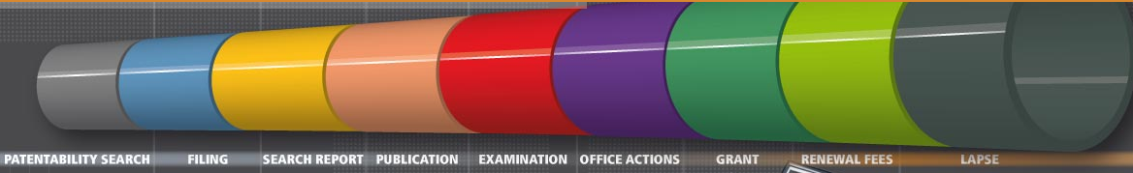
Example 1
Each patent application is in generally published 18 months after the priority/filing date.

Slide 25
Example 1
If the application has been already published and it is abandoned, it belongs to the prior art.
An abandoned application does not grant any monopoly to the applicant.

Slide 26

Example 2
Another example…
THANK YOU FOR THIS INTERVIEW!
I’M PROUD TO BE SO FAMOUS AFTER PUBLISHING A SCIENTIFIC PAPER ON MY INVENTION.
I’M PLANNING
TO PROTECT IT IN THE NEAR FUTURE BY A PATENT!

Slide 27
Example 2
When it was published?
Where?
What has been published?
Where a patent application can possibly be filed? (check for Countries and/or IP rights with a grace period)

Slide 28
Grace period
In some Countries, if an applicant/inventor files a patent application within a certain time after disclosing the invention, the earlier disclosure is not considered to be prior art to the patent application.
12 months (e.g. USA), 6 months (e.g. JP, SM).
Other IP titles (utility models, designs, …).

Slide 29
Example 3
Another example….
Dear M. Patent Attorney, I want to file a patent application on my invention!
I divulgated it on my internet website 1 month ago but I just withdrawn the internet page…

Slide 30
Example 3
It was available 3 months, 3 weeks or 20 minutes?
3 weeks “sufficiently long” (T1553/06, r.6.7.5)
No decision on 20 minutes (T1553/06, r.6.7.3)

Slide 31
Example 3
Requirement for availability (T1553/06, r.6.7.3)
Document could be found with a public engine
Using one or more keywords
All related to the essence of content of document
A document only accessible through non-public URL is not available to the public (unless the URL is so straightforward that it can be readily guessed) (T1553/06, r.6.6, 6.7.3, 6.8.3)

Slide 32
Summary
Defensive publications
Dating of documents
Brief overview of no-patent strategies

Slide 33
Dating of documents
There is a need to prove a date for a document, so as to determine if it belongs to the prior art.
State of the art
Publication of A
Filing of a patent application

Slide 34
Dating of documents
There is a need to prove a date in first to file systems: the first applicant of the patent is considered to be the rightful owner of the patent, regardless of whether or not he is the first inventor.
The first inventor cannot prohibit the first applicant from exploiting the invention (he has no monopoly, no exclusivity on his creation).

Slide 35
Dating of documents
However, in some Countries, the 1st owner of the technology (i.e. 1st inventor/company) may claim a "prior personal possession right", which will allow him/it (and only him/it) to use/manufacture/market… the invention, despite another patent owner's monopoly.
This right to exploit the invention can only be granted in some Countries by proving that serious preparation was made with a view to exploit the invention, which is often difficult to prove when the invention has been kept confidential within the Company.

Slide 36
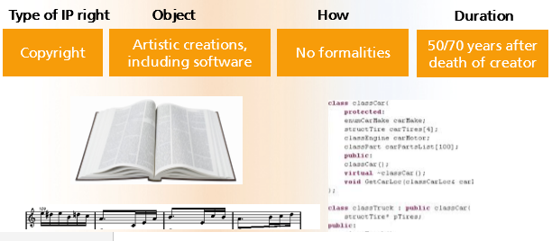
Dating of documents
There also exists a need to prove a date of creation in terms of copyright. In this case the work or the software is protected from the date of conception, but how can this be proved at a later date?

Slide 37

Dating of documents
Notary
« Enveloppe Soleau »
Registered mail
Filing documents at an IP Office
Blockchains

Slide 38
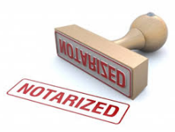
Notary
Pros | Cons
Safe | Cumbersome procedure
Limited costs | Not adapted for companies that create inventions or lines of code every day

Slide 39
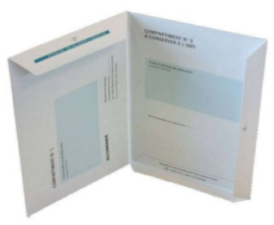
Enveloppe Soleau
France
Not an IP title.
Makes it possible to prove the existence of a creation/document on a given date from a given person.
Available at the INPI, 15 Euros/piece.

Slide 40
Enveloppe Soleau
Two compartments: one for you and the other for the INPI.
Insertion of the documents one wishes to date in each compartment (paper thickness 5mm max).
Once filled, the Soleau envelope must be folded and sealed and sent to the INPI.

Slide 41
Enveloppe Soleau
After registering and perforating the envelope to date it, the INPI return one of the two compartments to the person/company who filed it.
One must preserve it carefully, without opening/unclipping it!
The INPI keeps the other compartment in its archives for a period of 5 years, renewable once.

Slide 42
Enveloppe Soleau
If someone disputes the date of a creation or project: a judge can ask the INPI/Applicant to unpack the envelope.
The content of each compartment or the comparison of the contents of the two compartments can serve as piece of evidence of the information available/exact situation of a technical development at the filing date. It could serve also to establish the author(s) of such content of information.

Slide 43
e-Soleau
https://www.inpi.fr/fr/services-et-prestations/e-soleau (since 12.2016).
For each file filed, a fingerprint is calculated and stored in the INPI Electronic Archiving System.
Receipt by email mentioning the filing date, the list of the deposited documents and their respective fingerprints.

Slide 44
e-Soleau
Up to 300 MB in various formats (pdf, images, audio, video).
15 € / 10Mo, 10 € / 10Mo extra.

Slide 45
e-Soleau
Pros | Cons
Simple | Validity outside of FR borders is not clear
Low cost | Each envelope may contain no more than 3 files, max 100MB each
5y (+5y) | A new payment has to be made for each envelope
 | Designed for more occasional usage than the regular creation of evidences for company-wide processes

Slide 46
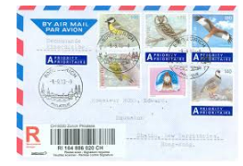
Registered email
Put all documents in an enveloppe and sent it to himself.

Slide 47
Registered email
Pros | Cons
Simple | Uncertain autentification (e.g. if the letter is opened or nor perfectly sealed)
Low cost | Validity is not clear
 | Not adapted for companies that create inventions or lines of code every day

Slide 48
Filing documents at an IP Office
For having a filing date in some Countries it is just required to send to an IP Office:
- an indication that a patent is sought
- information identifying the applicant or allowing the applicant to be contacted
- a description.

Slide 49
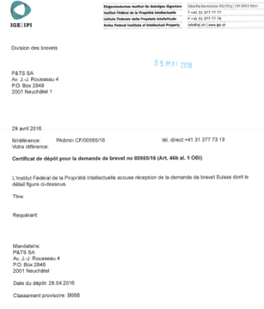
Filing documents at an IP Office
If a filing date is given, a filing certificate and a certified copy of the filed documents can be required to the IP Office.

Slide 50
Filing documents at an IP Office
Pros | Cons
Low cost | Requires at least basic knowledge of the patent system
Online filing possible | Useful for a possible patent, not efficient for copyright, prior use, etc.
The filing date can be exploited as a priority date

Slide 51
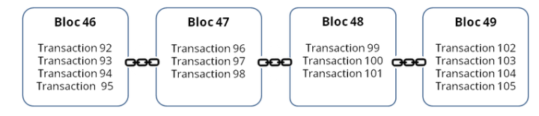
Blockchain technology
Information storage and transmission technology transparent, secure, without a central control.
Database containing the history of all the exchanges between its users since its creation. This database is secure and distributed: it is shared by its various users, without intermediaries, which allows each one to check the validity of the channel.

Slide 52
Blockchain technology
Public blockchains (open to all) and private blockchains (whose access and use are limited to a number of actors).
A public blockchain can therefore be assimilated to a public, anonymous and unfalsifiable public accounting book.
"a very large notebook that everyone can read freely and free of charge, on which everyone can write, but which is impossible to erase and indestructible" [mathematician Jean-Paul Delahaye]

Slide 53

Blockchain technology
https://www.bernstein.io/
Notarisation services for invention announcements based on blockchain technology. The downloaded document remains confidential, but it is possible to prove at a later date that it existed at the date it was uploaded and that it has not been modified.
It is also possible to request the publication of this document if required and to use it as a defensive publication.

Slide 54
Blockchain technology
https://www.bernstein.io/
Encrypting documents locally and registering a cryptographic fingerprint on the blockchain.
Nothing to install, no software or extensions. Bernstein is a regular web app that runs in any modern browser.

Slide 55
Blockchain technology
Pros | Cons
Simple | Not yet clear if a judge will trust it or consider it safe
Low cost
Possibility to link subsequent updates and proofs of use
Can manage high volumes of data

Slide 56
Summary
Defensive publications
Dating of documents
Brief overview of no-patent strategies

Slide 57
Overview of no-patent strategies
Publication
Do nothing
Confidentiality

Slide 58
Do nothing
Pros | Cons
No cost, no time | Risk of being copied
 | Competition based on price or distribution - Not on marketing or technological USPs
 | Risk of being blocked if a third party patents your solution

Slide 59

Confidentiality
Keep it secret
Notes:
trade secrets are protected against unfair use if:
The information is (more or less) confidential
It has value because of its secrecy.
But trade secrets are not protected if a competitor reinvents the same independently (and possibly patents it!), or access it in a legal way (for example through reverse engineering).

Slide 60
Confidentiality
Pros | Cons
Avoids the costs of patent filing | Might be very expensive (drafting and enforcing NDAs, protection measures, etc)
 | Employees might leave the company
 | Not available if the information is visible with the product
 | Difficulty to enforce NDAs or trade secrets
 | Risk of being blocked if a third party patents the solution
 | Often a time-limited solution
Notes:
For:
- Technology or software which cannot be revealed by reverse engineering
- Technology which does not fulfill the criteria for patentability
- Technology still under development, not yet mature
But also :
- Technical know-how, such as experience of implementing a product or service, additional knowledge to make a known procedure work or work efficiently
- Business information, such as list of clients or providers

Slide 61

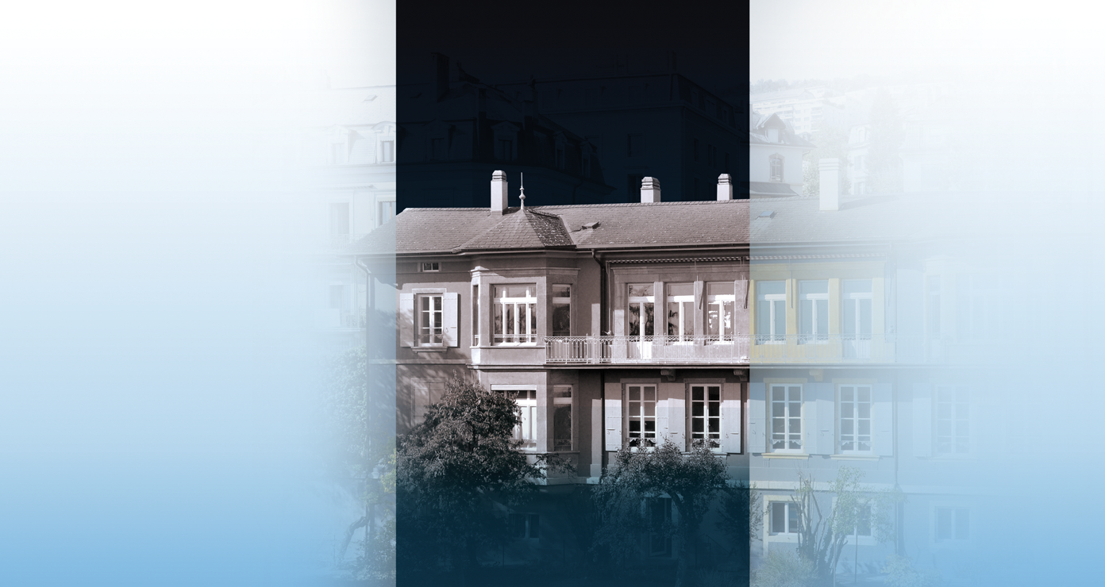
Thanks for your attention !
Av. J.-J. Rousseau 4 Nordstrasse 9
CH 2001 Neuchâtel CH 8006 Zürich
+41-32-7271427 +41-44-2673919
www.patentattorneys.ch

