Slide 1

Intellectual Property in IT
27.04.2017
Giovanni GERVASIO
Maria MAINA
Johannes WOLHMUTH

Slide 2


Summary
Brief overview of the law
Italian Patents and Patent Applications
Italian Utility Models
Possible propositions to clients

Slide 3
Summary
Brief overview of the law
Italian Patents and Patent Applications
Italian Utility Models
Possible propositions to clients

Slide 4
Legal references
Codice della proprietà industriale (Decreto legislativo 10 febbraio 2005 n.30): a single code comprising sections about trademarks, designs, patents, utility models, topographies, trade secrets, vegetal varieties, procedural provisions, professional patent attorney association, etc.)
Regolamento di attuazione del CPI (Decreto ministeriale 13 gennaio 2010): the “rules” of the IP code
Decreto ministeriale 27 giugno 2008: provisions about the search performed by the EPO
Decreto ministeriale 2 aprile 2007: provisions about fees
Decreto legislativo 27 giugno 2003: provisions about competence of the courts

Slide 5
Summary
Brief overview of the law
Italian Patents and Patent Applications
Italian Utility Models
Possible propositions to clients

Slide 6

Requirements to obtain a filing date
ON THE DATE OF FILING:
Applicant must be indetified or reachable
Description (or reference to a previous application)
Filing fees MUST be paid !!!
AT LATEST WITHIN TWO MONTHS FROM NOTIFICATION
Domicile in UE or EES (or representative)
AT LATEST WITHIN TWO MONTHS FROM THE FILING DATE
Application in Italian (or an Italian translation MUST be filed within 2 months from the filing)

Slide 7
Filing date requirements
Filing fees (electronic filing): 50 euro
Claim fees (for each claim after the 10th): 45 euro

Slide 8
The search
Performed by the EPO
For first filings only
No search fee (A224(1) CPI) !!!
English translation of the claims required (or fee of 200 euro to be paid)
Search Report + Written Opinion (in EN !!!)
Within 9 months from the filing date

Slide 9
Fee reductions
No filing fees or transcription fees for Universities (A2 D.M. 02.04.07)
No filing fees nor grant fees and suspension for annual fees for inventors in poor conditions (A228 CPI)
------------------------------------------------------------------------------------------------------------
Annual fees starting from the 5th year but possibility : - to pay them only when the patent is granted (A227(1) CPI) - to pay them grouped (e.g. annuities for years 5 to 10 at once)

Slide 10
Enforcement of the patent
21 regional courts in Italy (Milan and Turin with most experience)
Provisional measures (description, «sequestro», injunction) But: «Protective lettre» not possible
Compensation of the damage (A125 CPI) – possible to ask the return of the profits to the proprietor («retroversione degli utili»)
Filing infringement action of a patent application possible starting from - its publication or - its notification to the potential infringer
Special provision for contributory infringiment in the law similar to UPC or Germany (new A66bis to quater CPI)

Slide 11
Friendship agreement with San Marino
A San Marino patent is valid also for Italy and vice versa
Does not hold for EP-IT, PCT-SM or PCT-SM patents!!
San Marino patents have a novelty grace period of 6 months, while Italian patents don’t
→ For inventions disclosed by the applicant, a SM patent is still possible, while an EP or IT patent would be invalid.
Possible nullity judged according with the law of the Country granting the patent

Slide 12
Military inventions
Filing at EPO or Foreign Patent Offices NOT possible for
Applicant (person whishing to file a patent application)
Residence in IT
If object to be protected could be useful for Italy’s defence
After 90 days from the filing and if NO communications received, filing at EPO or Foreign Patent Offices is possible
«If object to be protected could be useful for Italy’s defence» → applicant responsability

Slide 13
Summary
Brief overview of the law
Italian Patents and Patent Applications
Italian Utility Models
Possible propositions to clients

Slide 14
Utility model
Novelty
Inventive concept different (special efficacy, comfort in its application or use)
Efficacy implies in general a technical progress (not possible to protect an alternative as in patents)

Slide 15
Utility model
10 years
No substantive examination
Possible to file at the same time a patent application and a utility model (A84(1) CPI)
UIBM can ask the applicant to convert or a patent application into an utility model (A84(2) CPI)
Divisional application into utility model possible

Slide 16
Conversion
Italian patent (application) → Italian utility model application
Nullity decision: withdraws patent, but accepts conversion to UM
Nullity action
EP-IT patent IT patent
(auxiliary) request for conversion to utility model (at any time before decision also in appeal)
Utility model
Divisional into UM request
Conversion request
IT patent application
Utility model application
Evtl. request of office to convert
Utility model application

Slide 17
Transformation Art. 135 EPC
European patent application → Italian patent application
Possible when EP application deemed to be withdrawn due to
Missing translation from Italian to E/D/F under Art. 14 EPC
EP application was not forwarded from UIBM to EPO under Art. 77 EPC
European patent (application) → Italian utility model application
Possible when EP (application)
deemed to be withdrawn
Withdrawn
Refused
Revoked

Slide 18
Summary
Brief overview of the law
Italian Patents and Patent Applications
Italian Utility Models
Possible propositions to clients

Slide 19
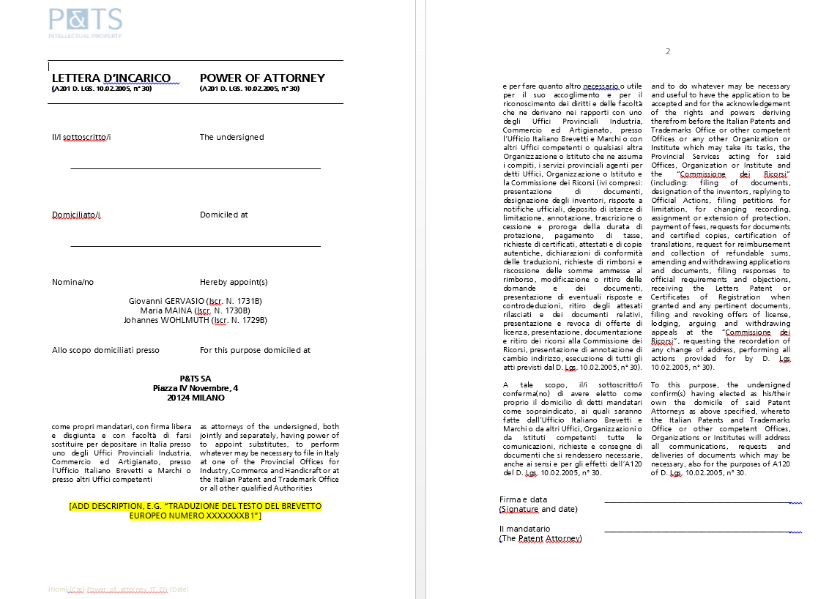
Validations of a EP patent
Power of attorney IT/EN available

Slide 20
Validations of a EP patent
Pay attention to the quality of the IT translation !
http://www.ordine-brevetti.it/upload/file/news/files/Rivista%2001%202017.pdf
First decisions in 2016 - Sentenze della sezione specializzata in materia di impresa, Tribunale di Milano, 03.01.2014, n. 3070 (Pres. Rel. Tavassi) e Corte d’Appello di Milano, 03.06.2016, n. 2205 (Pres. Mesiano – Rel. Schiaffino),

Slide 21
1st option
For clients who already know that IT is a strategic market
First filing: IT patent application in EN with a professional translation in IT of the patent application
Search Report + WO
Filing under IT priority
Validation in IT by exploiting the professional translation in IT of the patent application

Slide 22
2nd option
For startups
First filing: IT patent application in EN with a cheap translation in IT of the patent application
Search Report + WO
Abandon of the IT patent application and filing under IT priority

Slide 23


Merci de votre attention !
Av. J.-J. Rousseau 4 Nordstrasse 9
CH 2001 Neuchâtel CH 8006 Zürich
+41-32-7271427 +41-44-2673919
www.patentattorneys.ch

