Slide 1


The people in IP
MGT-404
Principles of IP Management
EPFL
25.04.2017
Christophe Saam

Slide 2
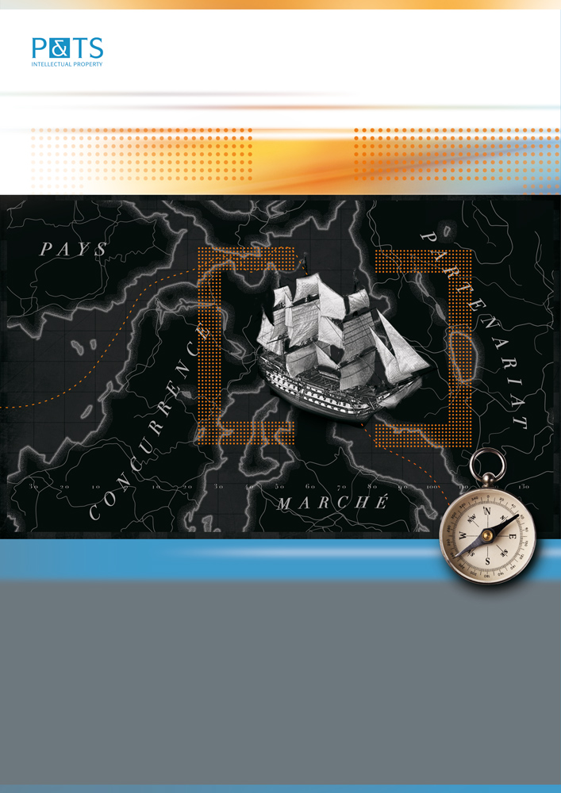
Introduction à la propriété intellectuelle
Christophe Saam
Ecole d’Art de la Chaux-de-Fonds
26 juin 2014
IP – an exploration of new territories
2

Slide 3

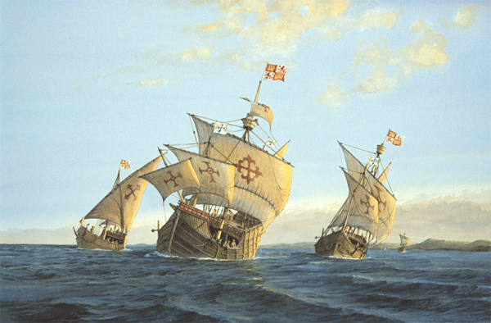
Previous explorers
The government grant claims for the exploitation of the new territories
Notes:
Christopher Columbus

Slide 4
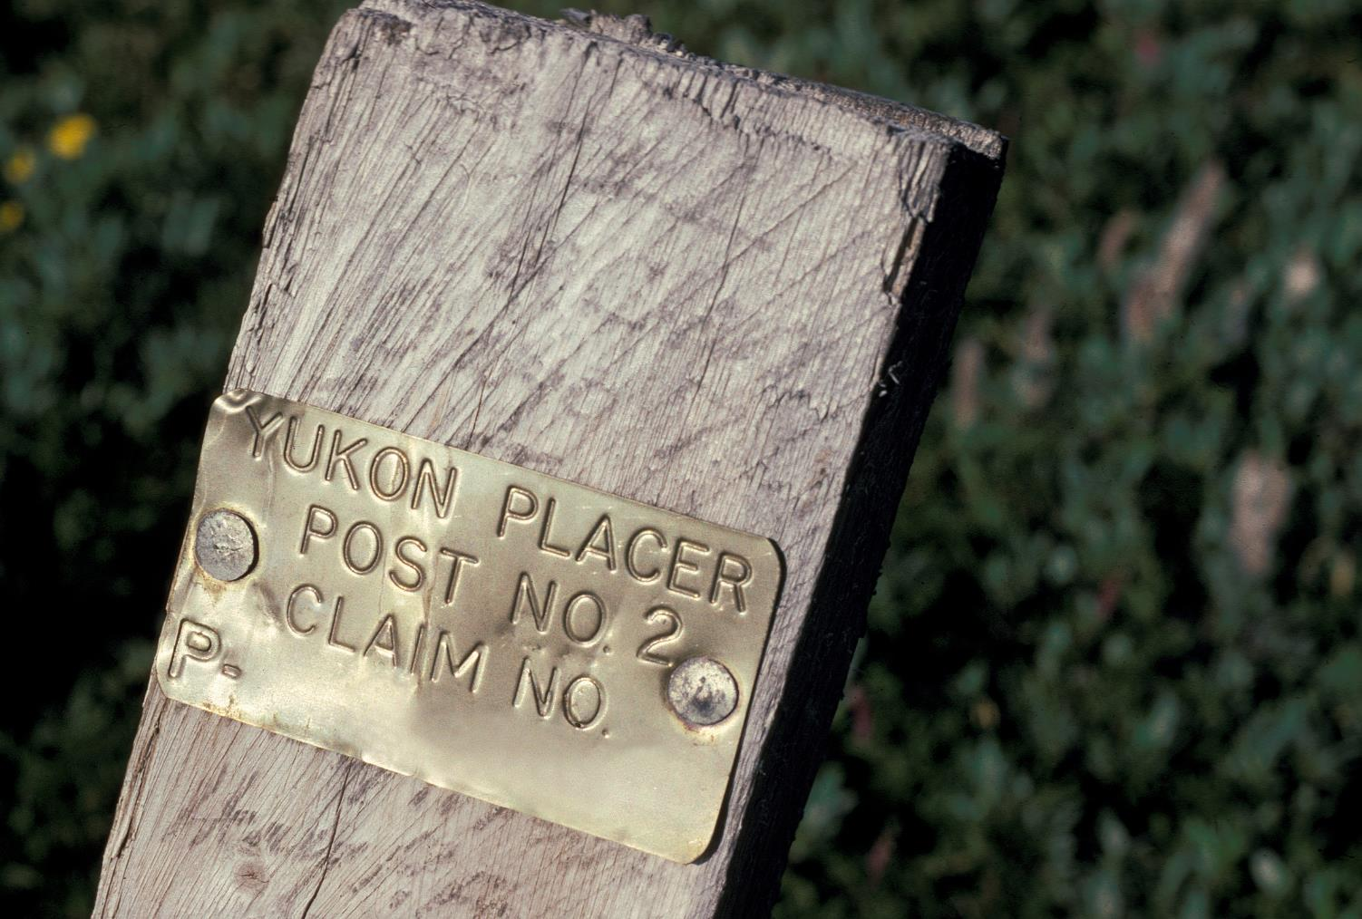
Awarding the explorers for their risks
The government grant claims for the exploitation of the new territories
Notes:
gold rush: Land claim for a right to extract minerals

Slide 5
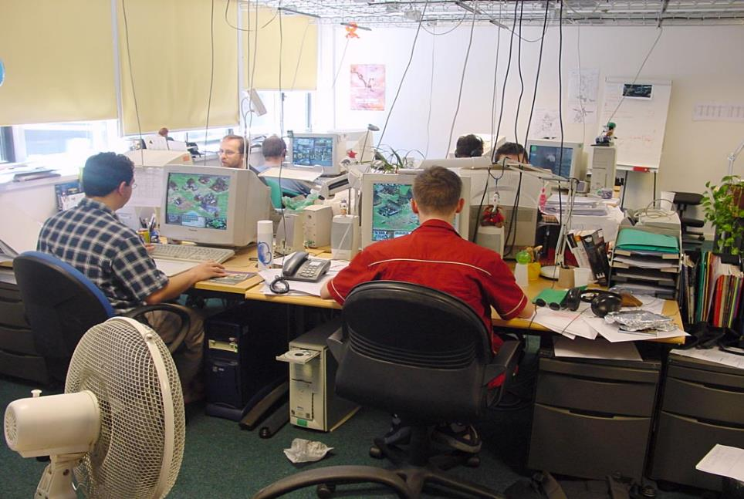
New explorers
The government grant claims for the exploitation of the new territories

Slide 6
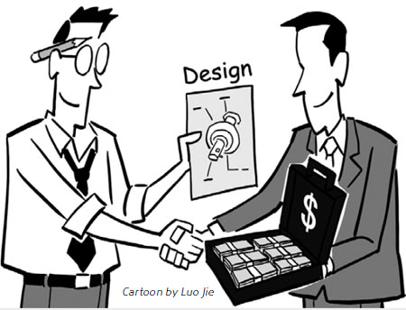
New awards
Patent claims
To protect your innovations from the competition

Slide 7
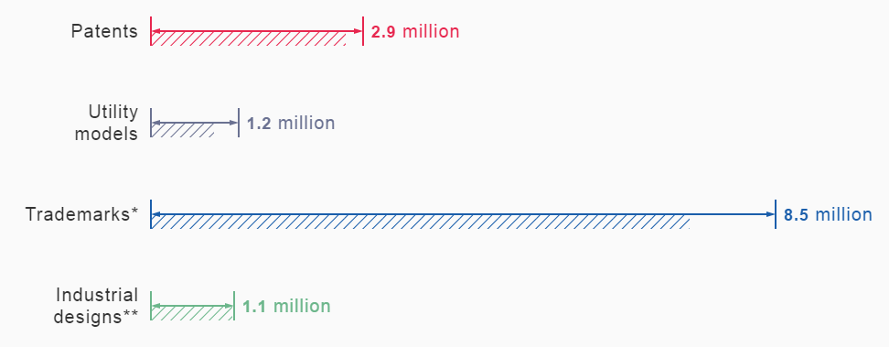
IP: a rather large industry
Source: WIPO, 2015
Notes:
A very attractive system, so that the number of patent application filed every year is becoming very high

Slide 8
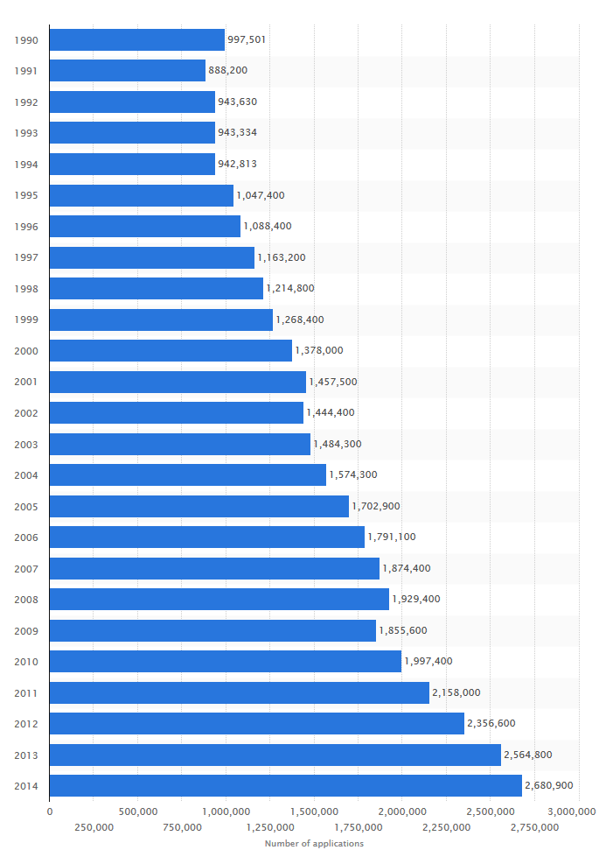
..and a growing one
An increase in
Number of inventions
Percentage of inventions that are protected
Number of participating countries

Slide 9

This IP industry transforms
creations into
IP Titles in order to
control their use
Invention
Design
Brand
..
Patents
Design
Trademark
..
Exclusive use
Licensing
Open Source
..
Prosecution
Litigation
Notes:
The product of this industry are IP rights, such as patents, industrial designs, trademarks, based on invention, design creations etc. They give to the owner a possibility to control the use of those creations, in any way they like

Slide 10
A wide range of IP related professions
Patent attorneys, patent agents, patent lawyers, patent examiners, judges, licensing specialists, TTO experts, patent information analysts, paralegals, IP brokers, patent translators, draftsmen, …
Notes:
Of course it requires many efforts and many people to produce this amount of patents. If you consider that each patent is in average a 20 pages legal and technical document, it is a huge amount of content that is produced every year. This requires a wide range of different professions, with different skills and different tasks

Slide 11
Patent Professions
 | Representative | Civil servant
Prosecution | Patent representative: Patent attorney / Patent agent | Patent Examiner
Litigation | Patent lawyer (Patent attorney) | Patent Judge
Misc | Licensing specialists TTO experts Patent information analysts Paralegals IP brokers Patent translators Patent Draftsmen
Notes:
We can distinguish between representatives, who are professionals defending the interests of a client, and civil servants, working for the government.
And we can distinguish between professionals active mainly during prosecution, in order to obtain the patents, and the one who are more in charge of litigation, in case of an infringement for example

Slide 12

Patent representatives
European/Swiss Patent Attorneys.
US Patent attorneys / US Patent agents
A technical background + a formation on patent law.

Slide 13
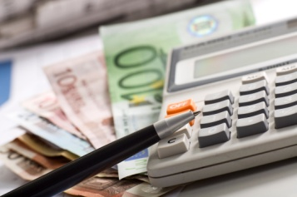
The tasks of a patent representatives
First discussion with a client who made an invention:
Should you patent your invention?
Cost/benefit analysis
New?
Is your invention patentable?
Conduct a prior art search
Patentable features.
Inventive?
Have you clarified the rights to the invention
with the company, its employees and business partners?
Original slide provided by EPO and by EUIPO. Changes have been made to the original, the modified version has not been authorized by the EPO or the EUIPO who are not responsible for the correctness of the modified version

Slide 14
If the invention is patentable:
The patent attorney put together a patent draft, compiles technical arguments to support the case, and files it with the patent offices in all countries where a protection is wanted.
The patent attorney is then responsible for prosecution the application, in order to obtain the best possible protection.
He often also advises the client on freedom-to-operate of the invention.

Slide 15
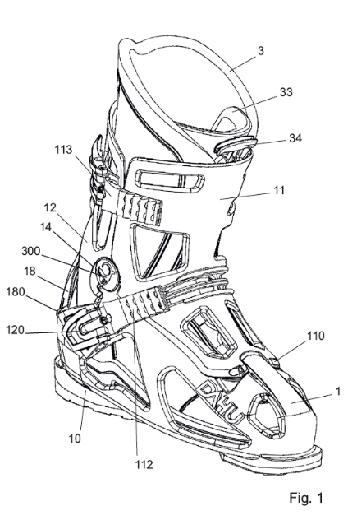
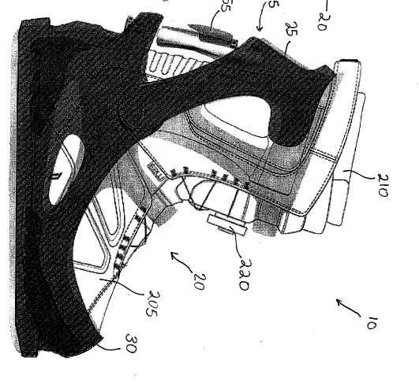
Example of invention
Dahu ski shoe
Prior art
With the permission of Dahu Ltd
Notes:
Inner shoe; external shell

Slide 16
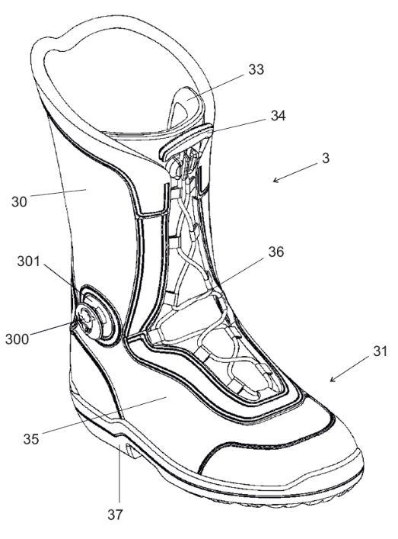
Description of the patent
Prior art
    Skiing shoes with inner shoe
    and external shell
Drawback of prior art
    Lack of rigidity
Problem to be solved
    Improve transmission of forces
    to the shell
Solution
    provide a pivot on the inner shoe,
    close to the ankle
Advantage of the invention
    Increased rigidity
With the permission of Dahu Ltd

Slide 17
Claims of the patent
Define the scope of protection
    1. Sport boot comprising:
    an inner boot;
    an external shell;
    said inner boot comprising a pivot protruding on the outer side close to the ankle;
    said external shell comprising a housing for accommodating the pivot.
Fictive example, with the permission of Dahu Ltd

Slide 18
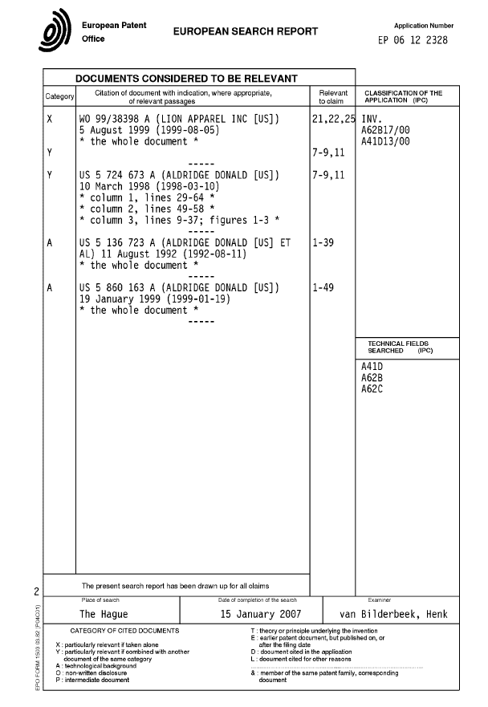
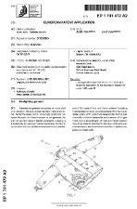
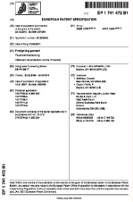
Prosecution with the EPO
Invention becomes
visible to the public!
Validation at
national offices
Application
filed
Search
report
Opposition
period expires
Publication
Examination
Grant
18 months
Approx. 4-5 years
9 months
Original slide provided by EPO and by EUIPO. Changes have been made to the original, the modified version has not been authorized by the EPO or the EUIPO who are not responsible for the correctness of the modified version

Slide 19

Tech transfer
The patent attorney also advises on technology transfer or license agreements, and prepares the legal documents.

Slide 20
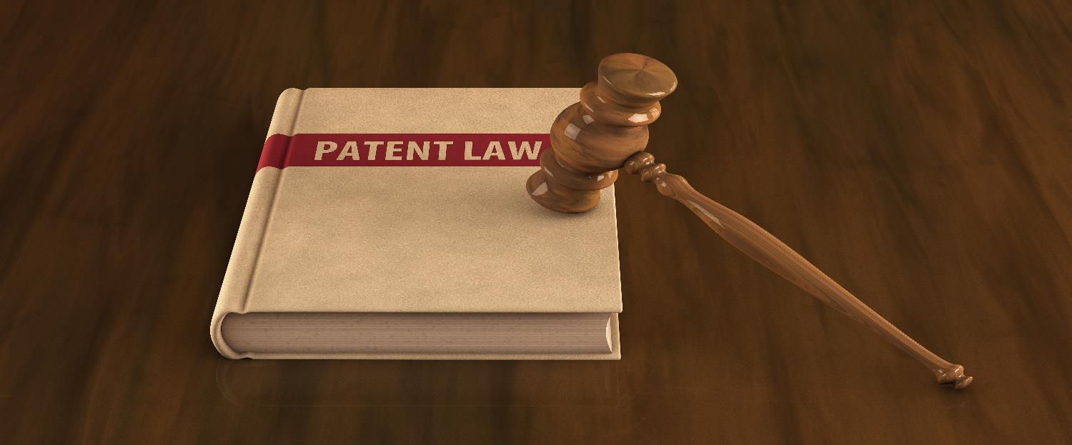
Litigation
In some countries, Patent Attorneys can represent the patentee in proceedings with patent courts, or in oppositions.
Notes:
For exemple in the US. In CH: for validity only.

Slide 21

European Patent Attorneys
A patent representative authorised to represent patent applicants in all proceedings with the European Patent Office.
>10’000 European Patent Attorneys
550 European Patent Attorneys in Switzerland:
220 are in one of the 126 patent law firms
330 are either in the industry, or inactive

Slide 22
How to qualify as a European Patent Attorney
University degree in science or technology
Three years working in the European patent profession, under the supervision of an appropriately qualified individual.
Usually: following CEIPI / EPI courses (not mandatory)
Pre-examination paper (Pass rate 75%)
European qualifying examinations: four written papers, held over three consecutive days (Pass rate 30%)
About 500 hours for the preparation.

Slide 23
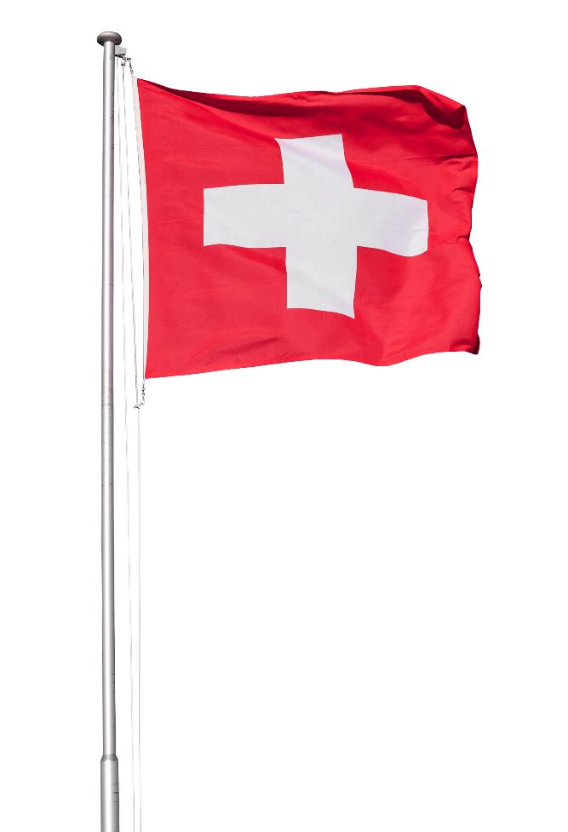
Swiss Patent Attorney
Protected title since 2011.
Another exam.
This title is not required for representing applicants with the Swiss Patent Office.
But it is required for the representation in litigation with the Swiss Federal Patent Court (for validity; and with a laywer for infringement)

Slide 24

Patent lawyers
Attorneys-at-law with a specialisation in IP or patents.
Main tasks:
Patent licensing
Patent litigation (often in collaboration with a patent attorney)
Often, trademark and design prosecution/litigation

Slide 25

Patent examiners
Patent examiners are employees of a patent office.
They review patent applications to determine whether the invention(s) claimed in each of them should be granted a patent or whether the application should instead be refused.
Source of the image: EPO / EUIPO

Slide 26
Patent examiner - task (2)
Smaller patent offices
Usually, only a formal examination: clarity; sufficient disclosure, ..
(e.g. Switzerland, France, Italy,..).
Larger patent offices
Substantive examination: formal+ novelty, inventive step
(e.g. Europe, US, Japan, China, …)
Notes:
CH: This involves reading the patent application and making sure that the scope of protection is clearly defined and sufficiently disclosed.
EP: patent examiners make a substantive examination to determine whether the invention fulfills the novelty and inventive step requirements.

Slide 27
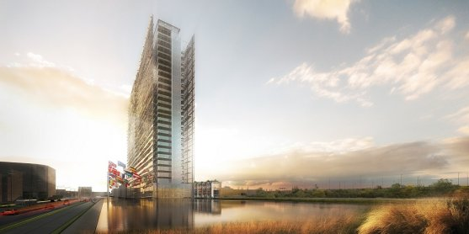
Examiners at EPO
Ca. 4’800 examiners
Munich (HQ),
The Hague, and Berlin

Slide 28
Typical tasks of an Examiner at EPO
Reading the patent application.
Searching in the prior art to retrieve similar inventions.
Issuing written office actions to explain the objections.
Granting patents if the issues raised have been solved
Managing oppositions if the patent is contested
Notes:
CH is a member state

Slide 29
Requirement to become a patent examiner at the EPO
Citizenship of one of the member States of the EPO.
Diploma of completed university studies at Master’s level in physics, chemistry, engineering or natural sciences.
An excellent knowledge of one official language (English, French and German) and the ability to understand the other two.
Notes:
CH is a member state

Slide 30
Internal formation at the EPO
The EPO provides a two-year training program for newly recruited examiners:
Classroom (computer tools, databases, search methods).
Legal and practical expertise.
Guided learning with a personally assigned coach.
Language skills.
Work on real-life patents.
Notes:
CH: This involves reading the patent application and making sure that the scope of protection is clearly defined and sufficiently disclosed.
EP: patent examiners make a substantive examination to determine whether the invention fulfills the novelty and inventive step requirements. This usually involves a search in the prior art to retrieve similar inventions), and issuing office actions to explain the objections.

Slide 31

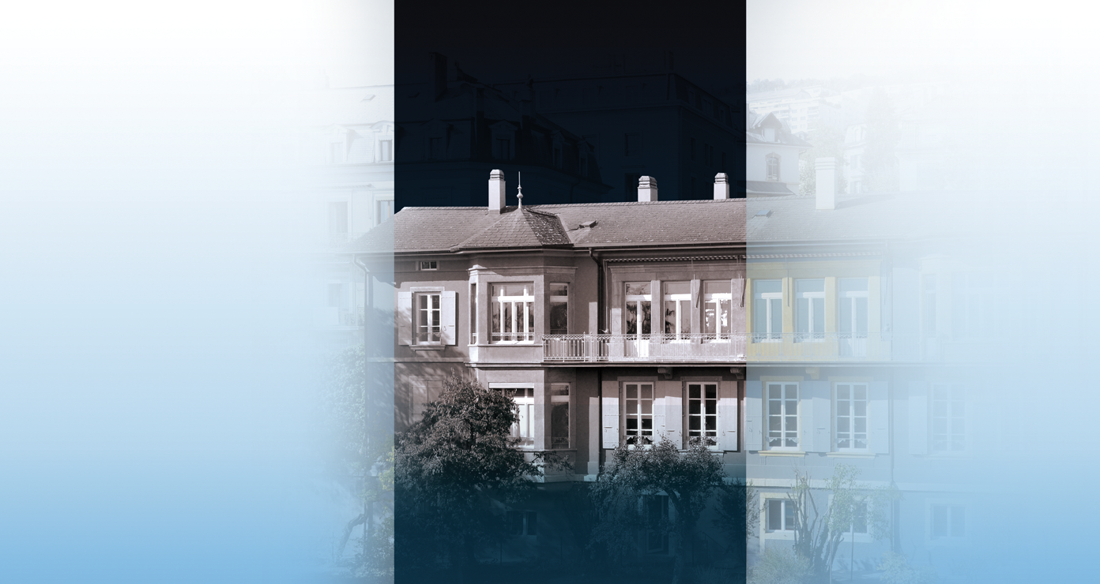
Thanks for your attention !
Av. J.-J. Rousseau 4 Nordstrasse 9
CH 2001 Neuchâtel CH 8006 Zürich
+41-32-7271427 +41-44-2673919
www.patentattorneys.ch

